Slide 1
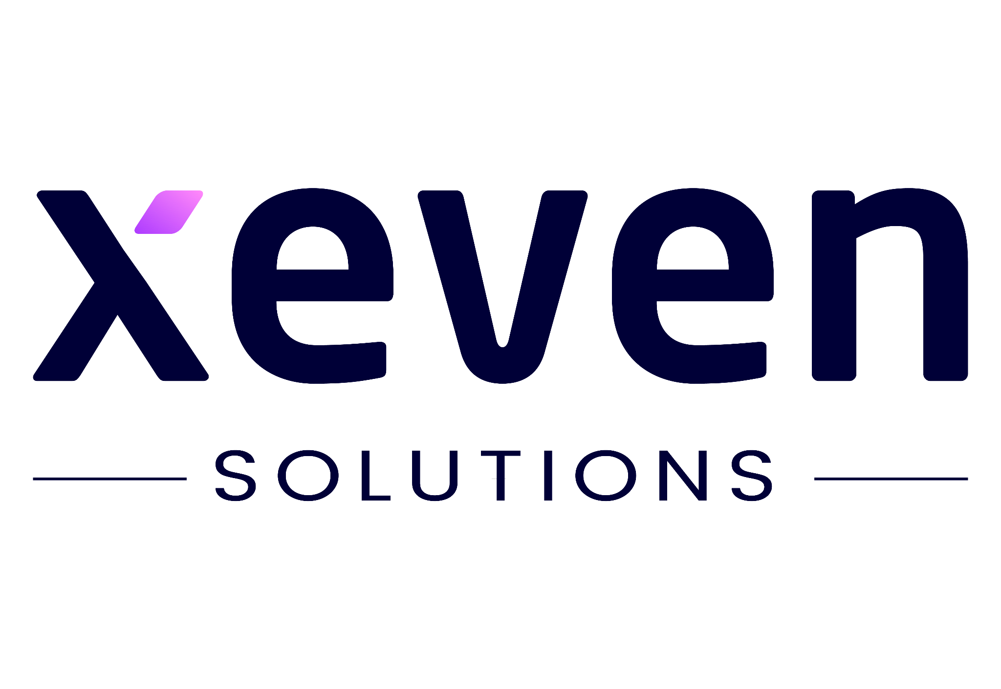

Hope to Skill
Crafting Tomorrow's Insights: The Art of Retrieval-Augmented Generation
From NLP Novice to Mastermind!
Lecture # 24
Irfan Malik
Dr. Sheraz Naseer
Dr. Shazia Saqib

Slide 2


Slide 3

Who we are?

Slide 4
Agenda
Introduction of the Course ?
Machine Learning vs Deep Learning
Natural Language Processing
Retrieval-Augmented Generation

Slide 5
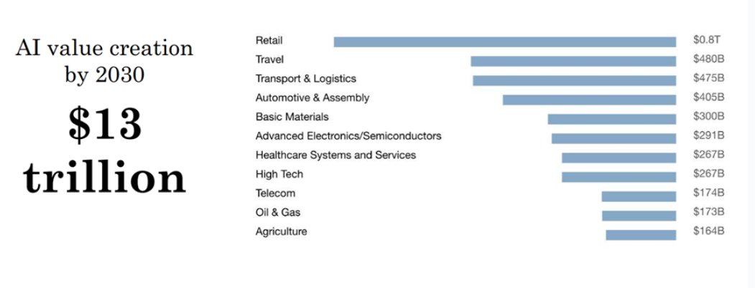
Financial Impact of AI

Slide 6
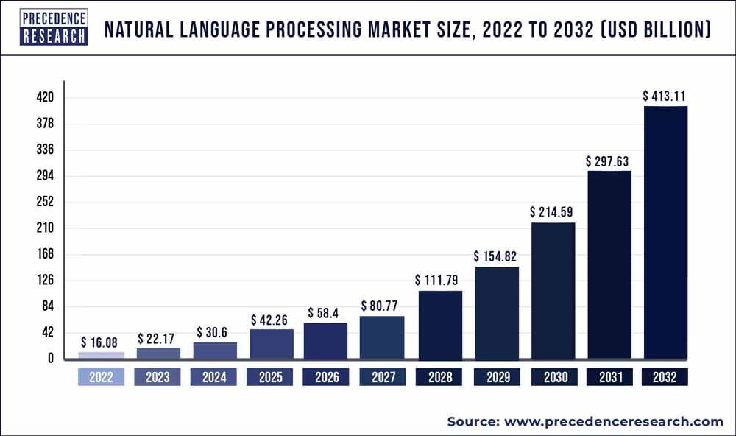
The global natural language processing market size is expected to hit around USD 413.11 billion by 2032
with a registered Compound annual growth rate (CAGR) of 38.4% during the forecast period 2023 to 2032.
https://www.precedenceresearch.com/natural-language-processing-market

Slide 7
Artificial Intelligence
Machine Learning
Deep Learning
Artificial Intelligence is the branch of computer science concerned with development of methods that allow computers to learn without explicit programming.
Machine Learning is a branch of AI, which focuses on methods, that can learn from examples and experience instead of relying on hard-coded rules and make predictions on new data.
Subfield of Machine Learning that focuses on Neural Networks (Inspired from Biological neurons) to develop learning models.

Slide 8
Relationship in AI, ML and DL
Machine Learning:
SVM, Tree Algorithms, Nearest neighbors, bagging, boosting, Deep Learning
Artificial Intelligence:
Search Algorithms, Rule Based Systems, Statistical Inference, Machine Learning
Deep Learning:
FCNs, CNNs, RNNs, Transformers, Autoencoders, GANs

Slide 9
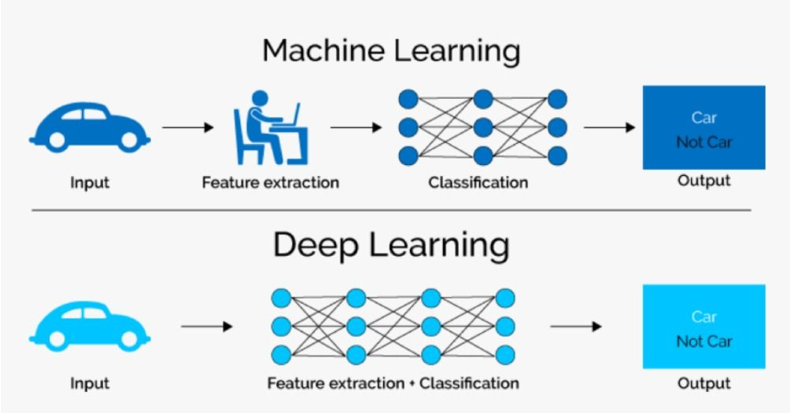
ML vs. DL

Slide 10
ML vs. DL

Slide 11
Natural Language Processing
Natural language processing (NLP) is the discipline of building machines that can manipulate human language — or data that resembles human language — in the way that it is written, spoken, and organized.
https://www.deeplearning.ai/resources/natural-language-processing/

Slide 12
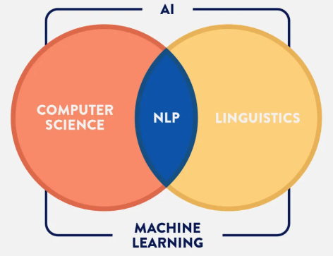
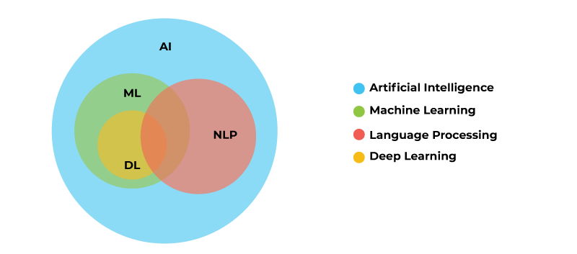
How NLP relates to AI
https://aiml.com/what-is-natural-language-processing-nlp-list-some-of-the-most-common-nlp-tasks/

Slide 13
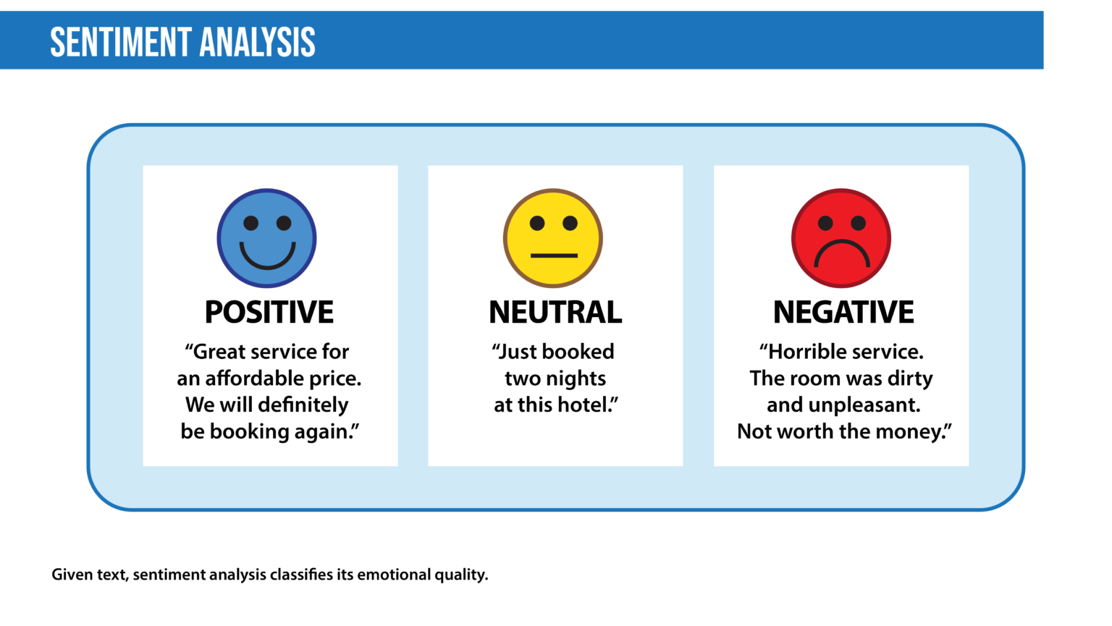
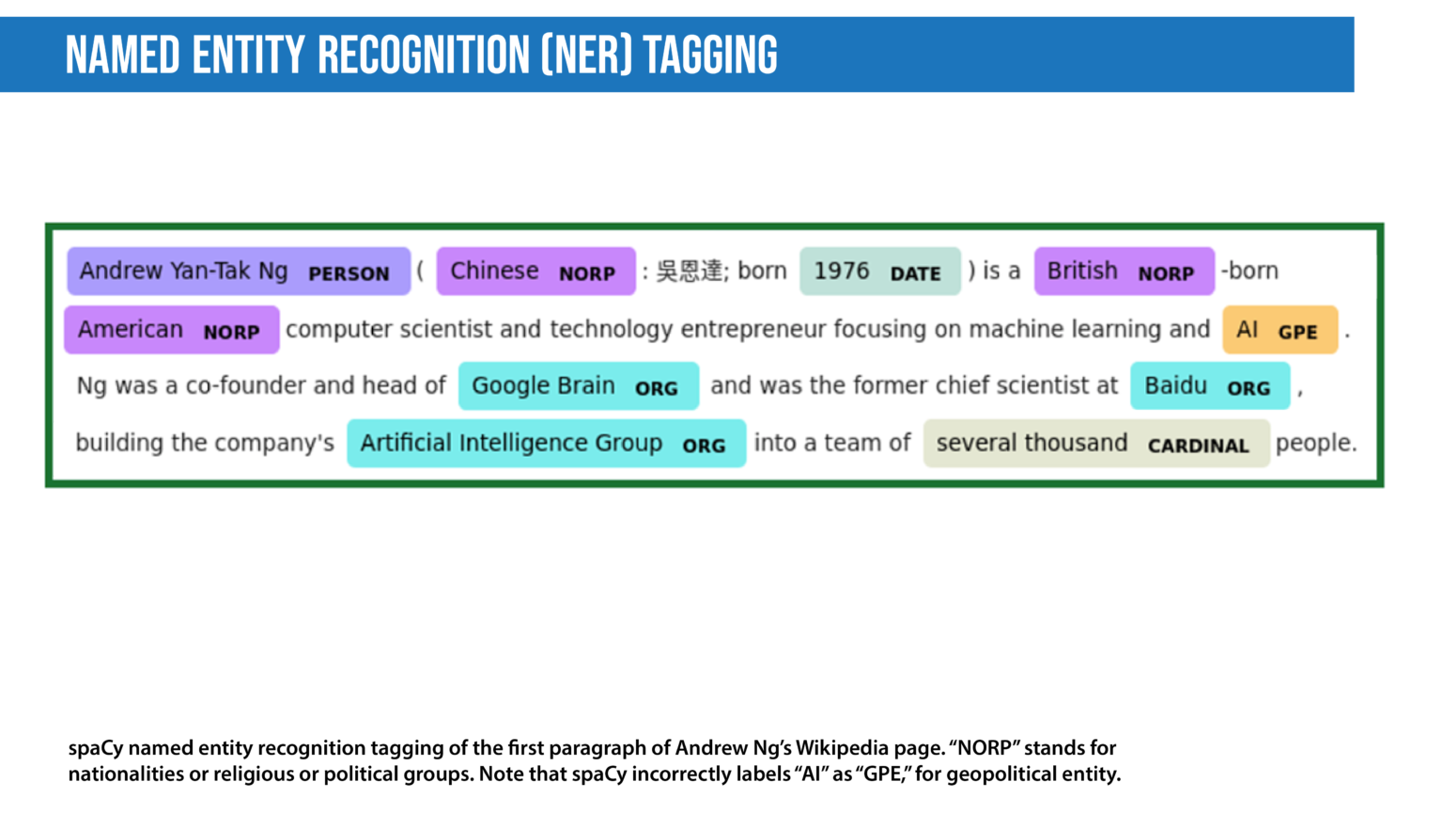
What is Natural Language Processing (NLP) Used For?

Slide 14
What is Natural Language Processing (NLP) Used For?(Contd)
Spam detection
Grammatical error correction
Information retrieval
Summarization
Question answering
Chatbots
Market Intelligence
Speech recognition

Slide 15
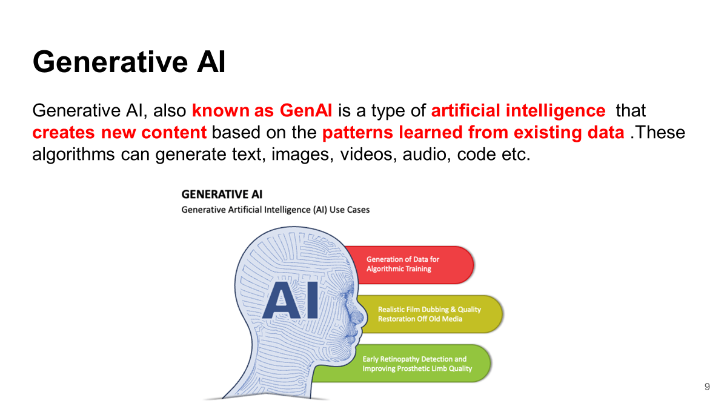

Slide 16
Generative AI
Text Generation
ChatGPT 3.5/4
Bard
Image generation
Dall-E3
Stable Diffusion
Music Generation
Music-LM
Video Generation
Runway ML Gen-2

Slide 17
Large Language Model (LLM)
A large language model (LLM) is a type of artificial intelligence (AI) program that can recognize and generate text, among other tasks. LLMs are trained on huge sets of data — hence the name "large." LLMs are built on machine learning: specifically, a type of neural network called a transformer model.
It's akin to distinguishing between an open-book and a closed-book examination.
In a RAG system, you're prompting the model to provide a response by perusing content within a book, rather than relying on recalling facts from memory.

Slide 18
Retrieval Augmented Generation
Retrieval-augmented generation (RAG) is a technique for enhancing the accuracy and reliability of generative AI models with facts fetched from external sources.
RAG is an AI framework for retrieving facts from an external knowledge base to ground large language models (LLMs) on the most accurate, up-to-date information and to give users insight into LLMs' generative process.
https://blogs.nvidia.com/blog/what-is-retrieval-augmented-generation/

Slide 19
Use Cases
Picture a bustling hospital where doctors navigate intricate medical cases daily.
Physicians diagnose and treat patients based on their vast medical knowledge. Yet, when confronted with complex illnesses or rare conditions, they often seek assistance from medical literature or consult with specialists.

Slide 20
Use Cases(Contd.)
In the realm of artificial intelligence, large language models (LLMs) function much like skilled doctors, adept at addressing a wide array of medical queries. However, to deliver well-informed responses backed by credible sources, they rely on a process analogous to a doctor's consultation with medical literature or specialists.
This process, known as retrieval-augmented generation (RAG), serves as the 'medical literature assistant' for LLMs, enabling them to provide comprehensive and authoritative insights to medical queries

Slide 21
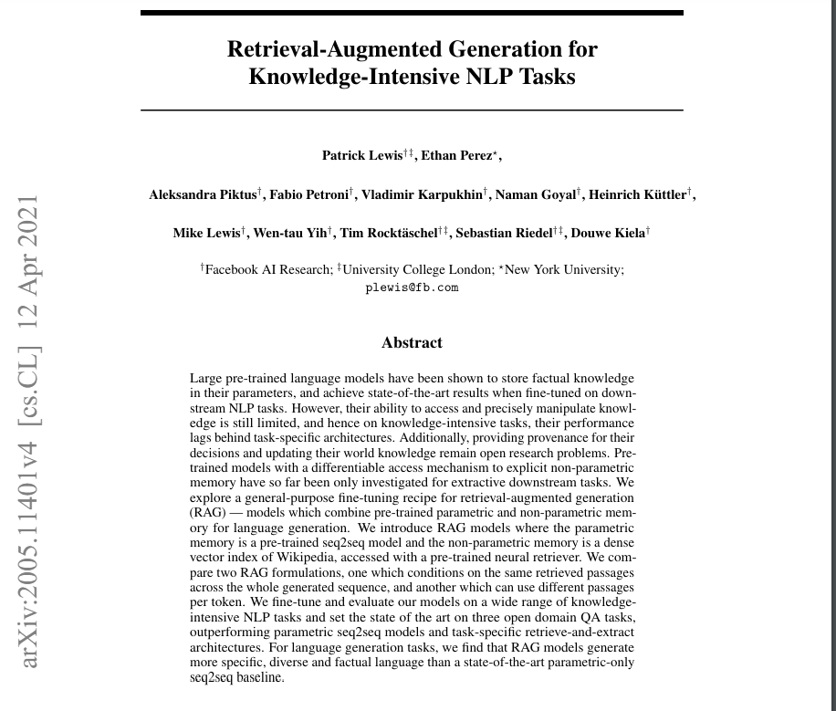

Slide 22
Building User Trust
Retrieval-augmented generation gives models sources they can cite, like footnotes in a research paper, so users can check any claims. That builds trust.

Slide 23
Summary
What is NLP?
Generative AI
Large Language Model (LLM)
Retrieval Augmented Generation (RAG)

